Slide 1

OPERATING SYSTEM
By Walubita .N.
Kapasa Makasa University

Slide 2
OPERATING SYSTEM BASICS
Operating System is essential software that is required for a computer to become operational. It provides functionality to computer hardware, so that electro-mechanical components of it perform read, write and processing functions as human being do.
Without operating system, computer cannot work. In the absence of operating system, neither input devices will be able to provide data to the computer nor memory will be able to store anything it nor processor will be able to process the data nor output devices will be able to show the result.

Slide 3
MAJOR FEATURES OF THE OPERATING SYSTEM
Perform internal management functions.
Provide services.
Provide user interface.
USER INTERFACE
While working on computer, user has to interact with computer. For example, if a program is to be executed, user has to communicate to the computer that this is the program, which is to be executed. Note that different operating systems provide different ways of interacting with computer. In computer terminology, the method of interaction is often referred to as user interface.

Slide 4
User interfaces are basically of two types:
1. Command Line Interface (CLT).
2. Graphical User Interface (GUI).
Command Line Interface
In command line interface, user interacts with the computer by typing the commands in specified format. Thus he mostly makes use of keyboard to interact with the computer.

Slide 5
Graphical User Interface
In graphical User Interface (GUI), user interacts with the computer through graphical items, such as icons, menus dialog boxes etc.
As and when required, these items automatically appear on the monitors and user has to simply select his choice from the displayed items, by clicking the mouse on desired option.
Thus in this type of communications, user mostly makes use of mouse to interact with computer.

Slide 6
TYPES OF OPERATING SYSTEMS
Operating systems can be broadly classified into following categories:
1. Single user operating systems
2. Multi user operating systems
3. Network operating systems

Slide 7
Single User Operating Systems
Single user operating systems are those operating systems, which allow only one user to work on the system at a time. In no way, multiple users can work on the system simultaneously.
Single user operating systems can be broadly categorized into two categories:
1.Single user single task operating systems.
2. Single user multitasking operating systems

Slide 8
Single user single task operating systems allow user to execute one program at a time. For example, if he is preparing a worksheet on computer, he cannot print a report on the printer. As soon as he invokes a program, computer gets dedicated to that task only.MS-DOS etc. are few examples of single user single task operating systems.
Single user multitasking operating systems allows user to execute more than one programs at a time. For example, while he is preparing a worksheet on computer, he can print a report on the printer and play music too. Practically there is no limit from operating system's side for the number of tasks that can be executed simultaneously.

Slide 9
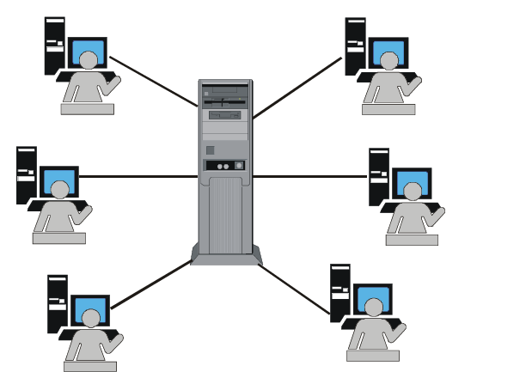
Multi-User Operating Systems
Multi-User operating systems are larger and more complex operating systems. They allow multiple users to work on the system simultaneously. Following are the features of multi-user operating systems, which are not provided in single user operating systems.
• Time sharing (CPU devotes time to all the users in round robin fashion).
• Tight security features.
• Resource sharing among users.
• System administrator privileges.

Slide 10
Network Operating System
When two or more computers are connected to each other with the objective of sharing their resources, they form a computer network. A network operating system is an operating system, which includes special functions, protocols and device drivers for connecting the computers of the network. When a computer is booted with network operating system, all computers get connected together and the network becomes operational.

